Slide 1

Project Title:
Seasonal Agriculture performance analysis
Name: Adrija Dutta
College Name: IQ City United World School Of Business
AICTE STU ID : STU6a6623c3585da1785078723

Slide 2

PROBLEM STATEMENT
Agricultural activities are influenced by seasonal variations in environmental conditions, farming practices, resource availability and market conditions. As a result, agricultural performance may differ from one season to another.
However, raw agricultural data does not clearly explain how agricultural performance changes across seasons or what patterns can be observed in different seasonal conditions.
The problem is to analyze the given agricultural dataset and investigate seasonal differences in agricultural performance by identifying meaningful patterns, trends, relationships and variations within the available data.

Slide 3
Project Description
Seasonal variations can influence different aspects of agricultural activities and performance.
Understanding seasonal patterns through data analytics can help stakeholders:
• Understand variations in agricultural performance
• Identify important seasonal trends
• Compare performance across different periods
• Understand changing environmental conditions
• Examine differences in resource usage
• Identify areas requiring further investigation
• Support evidence-based agricultural planning

Slide 4

WHO ARE THE END USERS?
Farmers (the direct end users)
Agricultural Extension Officers / Advisors
Irrigation Equipment & Input Companies
State Agriculture Departments / Government Policy Makers
Agri-Lenders, Banks & Crop Insurance Providers
Agri-Business, Traders & Procurement Companies
This analysis helps its end users by shifting seasonal agricultural decisions from guesswork to evidence: it shows that seasonal losses from falling water efficiency and flat costs rather than poor field, and that certain crops (Rice, Wheat) lose money regardless of season while others stay profitable year-round, and that some states manage the seasonal dip far better than others.
With this, farmers can time crop choices and irrigation investment more wisely, policymakers can target support where it's actually needed, lenders and insurers can price risk more accurately by season and crop, and businesses can plan supply and irrigation offerings around real seasonal patterns — overall turning a generic dataset into a practical, season-aware decision tool for anyone involved in planning, funding, or profiting from agriculture.

Slide 5

Technology Used
  Python
  Pandas
  NumPy
  Matplotlib
  Seaborn

Slide 6
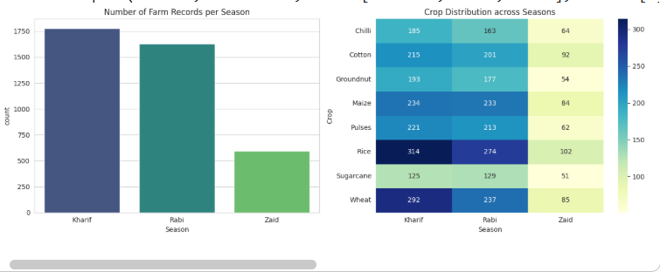
RESULTS

Slide 7
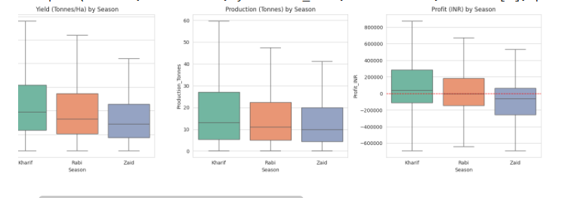
RESULTS

Slide 8
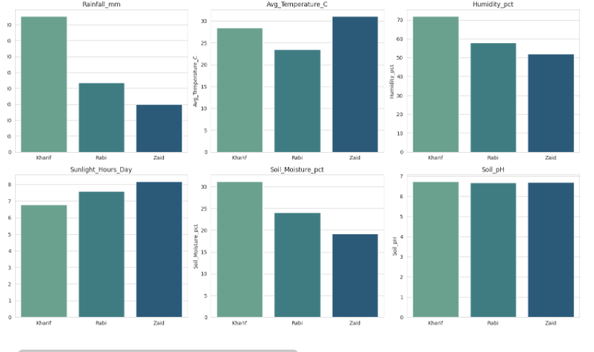
RESULTS

Slide 9
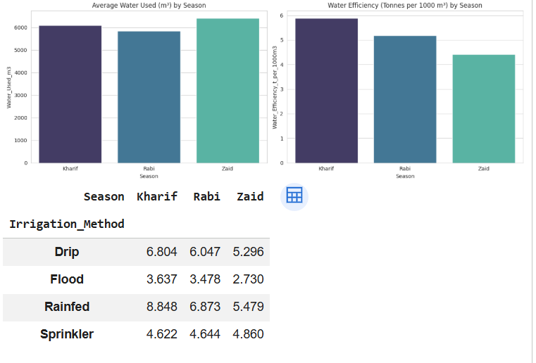
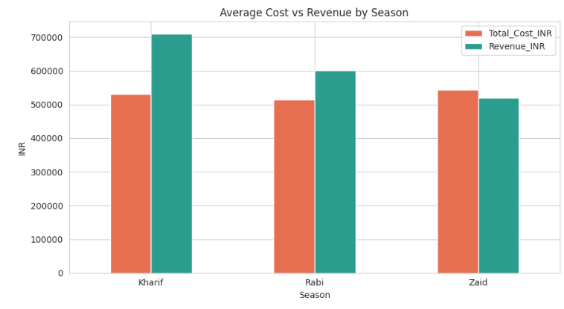
RESULTS

Slide 10
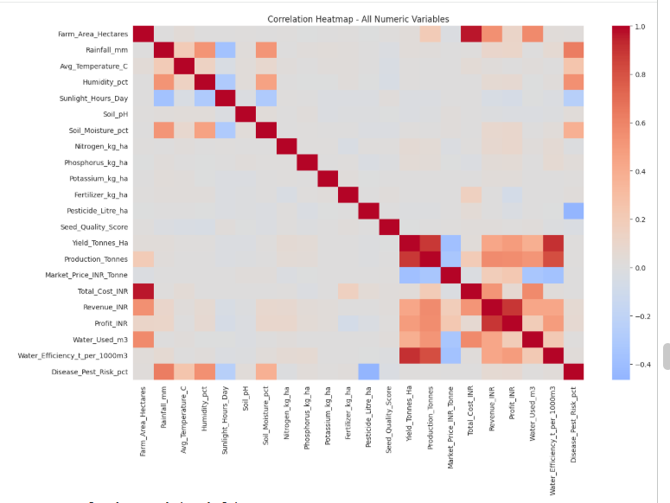
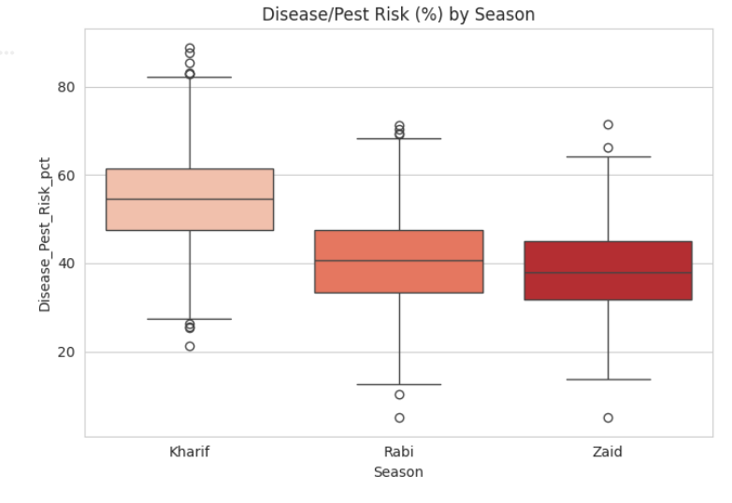
RESULTS

Slide 11
Future scope
This analysis shows that seasonal agricultural performance in this dataset is driven far more by economic dynamics (fixed costs vs. falling seasonal output/revenue) than by raw field capability, which stays statistically similar across seasons.
Kharif is the strongest season overall — higher rainfall and moisture support higher output and revenue despite the highest pest pressure, while Zaid is structurally the weakest, combining the lowest water efficiency, lowest revenue and highest share of loss-making farms, with costs that do not adjust downward.
Crop selection and irrigation method are two of the most actionable levers available to farmers and planners to offset these seasonal effects, and their impact is consistent enough across states to support region-wide, evidence-based seasonal planning.

Slide 12
GitHub Link:
https://github.com/adrijadutta19-create/Seasonal-Agriculture-performance-analysis.git

Slide 13

VOIS Course completion certificate -
Course name- Data Visualization

Slide 14
Thank You

